Slide 1
Day 2
PROCESS MODELS

Slide 2
Software
Engineering
Software Engineering

Slide 3
What is meant by Software Engineering?
Software engineering is the systematic approach to the development, operation, maintenance and retirement of software with reliable cost.

Slide 4
WATER FALL ‘Or’ LINEAR SEQUENTIAL MODEL
Requirements
&
Planning (Analysis)
Design
(data structure,
s/w architecture,
procedural details,
Interface
characterization)
Coding
Testing
Implementation
&
Maintenance

Slide 5
Requirements
&
Planning
Design
Coding
Implementation
Testing
ITERATIVE MODEL

Slide 6
Start
Stop
Requirements
gathering &
refinement
Engineer
product
Quick
design
Refining
prototype
Building
Prototype
Customer
evaluation of
prototype
PROTOTYPE MODEL

Slide 7
Planning
Risk analysis
Initial requirements
gathering &
project planning
Risk analysis based
on initial requirements
Risk analysis based
on customer reaction
Planning based on
customer comments
Go, no-go decision
Towards a completed
system
Initial software prototype
Customer evaluation
Next level prototype
Engineered system
Customer evaluation
Engineering
SPIRAL MODEL

Slide 8
Validation: Are we doing the right job?
Verification: Are we doing the job right?
Validation typically involves actual testing and takes place after verifications are completed.
Verification typically involves reviews and meetings to evaluate documents, plans, code, requirements, and specifications.

Slide 9
V & V PROCESS MODEL
Req
Architecture
Master Test
Strategy
Release
Acceptance Test
&
Certification
Project
Planning
Test
Planning
Integrated
Solution
P.T
&
Busi Cycle Testing
HLD/LLD
IF Design
Module
Test Case
des
App
Integration
Incremental
Integration
Testing
Solution
Mapping/
Development
System Testing
(Module Level)

Slide 10
Waterfall Model of the Testing Process
1. Test Planning
2. Test Design
3. Test Implementation
4. Test Execution
5. Execution Analysis
6. Result Documentation
7. Final Reporting

Slide 11
What is the tester’s role?
Understanding the process and not just the product
Verifying the functionality of product features
Validating the features – ensuring against assumptions
Observing & reporting
Providing timely information regarding quality
Owning/driving quality
Serving as advocate for our customer
  “…put yourself in the software user’s place to verify that it behaves the way it’s supposed to…” — Beizer, 1995

Slide 12
Attitude of a Tester
I perform at least as well as another expert would
I deliver useful results in a usable form
I choose methods that fit the situation
I make appropriate use of available tools and resources
I collaborate effectively with the project team
I can explain and defend my work
I can advise clients about the risks and limitations of my work

Slide 13
Definitions
Test: An activity in which a component is executed under specified conditions, the results are observed or recorded and evaluated with the expected outcome or target.
Test Bed: An environment containing the simulators, tools and other support elements needed to conduct a test.
Test Plan: Test Plan refers to the document that plans for testing of a system or component under various criterion of the testing strategy and procedures.

Slide 14
Definitions (contd.)
Test Case: A document that specifies the test
inputs, execution conditions, and predicted results
for an item to be tested with respect to the testing
criteria.
Test Driver: A test driver is a simulation of a control module. It performs the two functions of repeatedly calling the lower module being tested and passes input data to the lower module in each call.
Test Stub: A test stub is a dummy program module used by the driving / controlling units. It gets invoked by a function call and posts an action to notify execution.

Slide 15
Definitions (contd.)
Defect
  A deviation from specification or standard
  Anything that causes customer
  dissatisfaction
Verification
  All QC activities throughout the life cycle that ensure that interim deliverables meet their input specification
Validation
  The ‘test phase’ of the life cycle which
  assures that the end product meets the
  user’s needs

Slide 16
Testing and Debugging
The two term are often used together; some programmers use them interchangeably
Purpose of Testing
  Show that a program has bugs
Purpose of Debugging
  Find the error/ misconception that led to failure and implement program changes that correct the error

Slide 17
Debugging
Debugging is the act of attempting to determine the cause of the symptoms of malfunctions detected by testing or by frenzied user complaints

Slide 18
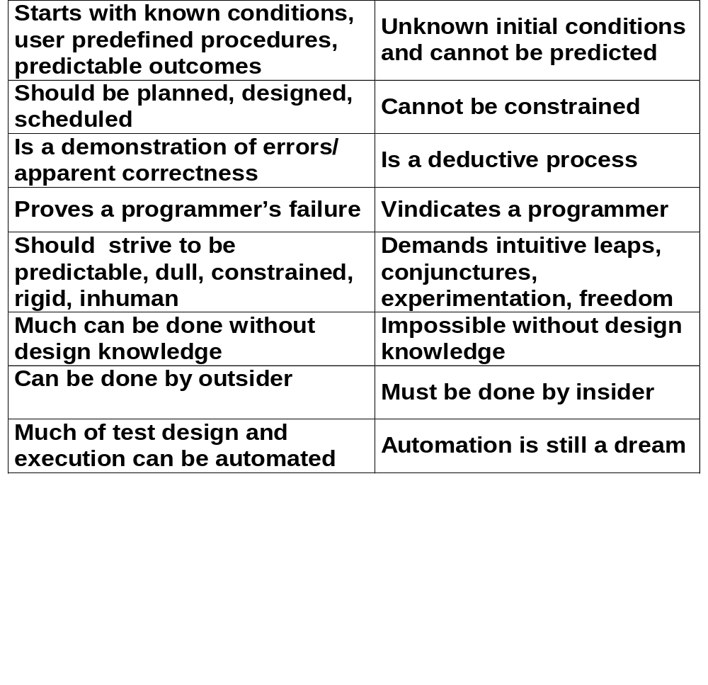
Testing and Debugging

Slide 19
BUG/DEFECT (ISO)
serious form of an anomaly (which affects an intended use).
BUG
CRITICAL
HIGH/MEDIUM
LOW/ENHANCEMENT

Slide 20
BUG/DEFECT Life Cycle
Retest Fixed Bugs
Close/Reopen Bugs
Find & Report Bugs
Bugs Being
fixed
by Developers

Slide 21
Costs of Errors Over the Life Cycle
The sooner an error can be found and corrected, the lower the cost.
Costs can increase exponentially with time between injection and discovery.
An industry survey showed that it is 75 times more expensive to correct errors discovered during ‘installation’’ than during ‘‘analysis’’.
One organization reported an average cost of $91 per defect found during ‘‘inspections’’ versus $25,000 per defect found after product delivery.

Slide 22
5 common problems in the software development process
Poor requirements
Unrealistic schedule
inadequate testing
featurisms
miscommunication

Slide 23
References
Introducing Software Testing
  By Louise Tamres
Computer Software Testing
  By Cem Kaner

